Slide 1
The Five Types of Plagiarism
Are You Stealing Intellectual Property?
Adapted from Instructor Theresa Ireton’s in-class presentation
https://www.centralia.edu/academics/writingcenter/Event%20Info/Plagiarism.ppt

Slide 2
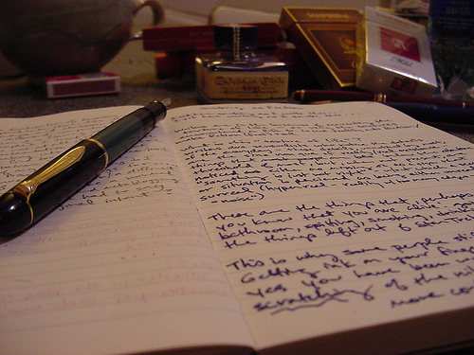
What is Plagiarism?
Presenting another’s original thoughts or ideas as your own
Using another’s exact words without proper citation

Slide 3
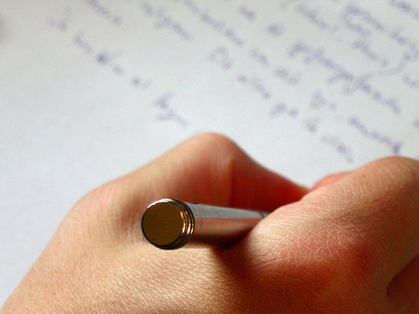
Strategies to Avoid Plagiarism
Isolate the reasons why plagiarism occurs
Identify the different types of plagiarism
Integrate plagiarism prevention

Slide 4
Unintentional Plagiarism
Paraphrasing poorly: changing a few words without changing the sentence structure of the original, or changing the sentence structure but not the words.
Quoting poorly: putting quotation marks around part of a quotation but not around all of it, or putting quotation marks around a passage that is partly paraphrased and partly quoted.
Citing poorly: omitting an occasional citation or citing inaccurately.
MLA handbook for writers of research papers. (7th ed.). The Modern Language Association of America. New York: 2009. Print.

Slide 5
Intentional Plagiarism
Passing off as one’s own pre-written papers from the Internet or other sources.
Copying an essay or article from the Internet, on-line source, or electronic database without quoting or giving credit.
Cutting and pasting from more than one source to create a paper without quoting or giving credit.
Borrowing words or ideas from other students or sources without giving credit.
MLA handbook for writers of research papers. (7th ed.). The Modern Language Association of America. New York: 2009. Print.

Slide 6
Paraphrasing vs quoting
https://www.youtube.com/watch?v=qoCdhJsS6Bw

Slide 7
Plagiarism Prevention: Be authentic
Develop a topic based on previously written material but write something new and original
Rely on opinions of experts on a topic but improve upon those opinions
Give credit to researchers while making your own contribution
Follow a standard documentation method such as MLA or APA format

Slide 8
The First Type of plagiarism
Plagiarism of Words
The use of another’s exact words without citing the author
Incorrect
Plagiarism is the reproduction of someone else’s words, ideas or findings and presenting them as one’s own without proper acknowledgement.
Correct
Plagiarism is the “reproduction of someone else’s words, ideas or findings and presenting them as one’s own without proper acknowledgement” (Undergraduate Course Handbook: 2008, p.24)

Slide 9
The Second Type of plagiarism
Plagiarism of Structure
Paraphrasing another’s words by changing sentence construction or word choice with citation
Paraphrasing while maintaining original sentence construction with acknowledging the source

Slide 10
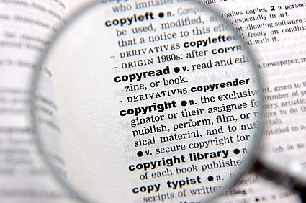
The Third Type of plagiarism
Plagiarism of Ideas
Presenting another’s
ideas as your own
without giving the
person credit
Submitting a paper
without citing or
incorrectly citing
another’s ideas

Slide 11
The Fourth Type of plagiarism
Plagiarism of Authorship
Turning in a
replication of
another’s work
Submitting a paper
that you got off the
internet or from a
friend and presenting
it as your own

Slide 12
The Fifth Type of plagiarism
Plagiarism of Self
The use of previous work for a separate assignment
Although these were you original words and thoughts, receiving credit for a previous assignment is considered cheating

Slide 13
The Penalties of Plagiarism
Although plagiarism can be intentional or unintentional, both have consequences. A meeting with the VP of Students will be scheduled to determine an outcome
Receiving zero on the assignment
Failing the course
Suspension
Expulsion – at the college level

Slide 14
For more Information go to:
Purdue OWL @ https://owl.english.purdue.edu/owl/resource/560/1/

