Slide 1
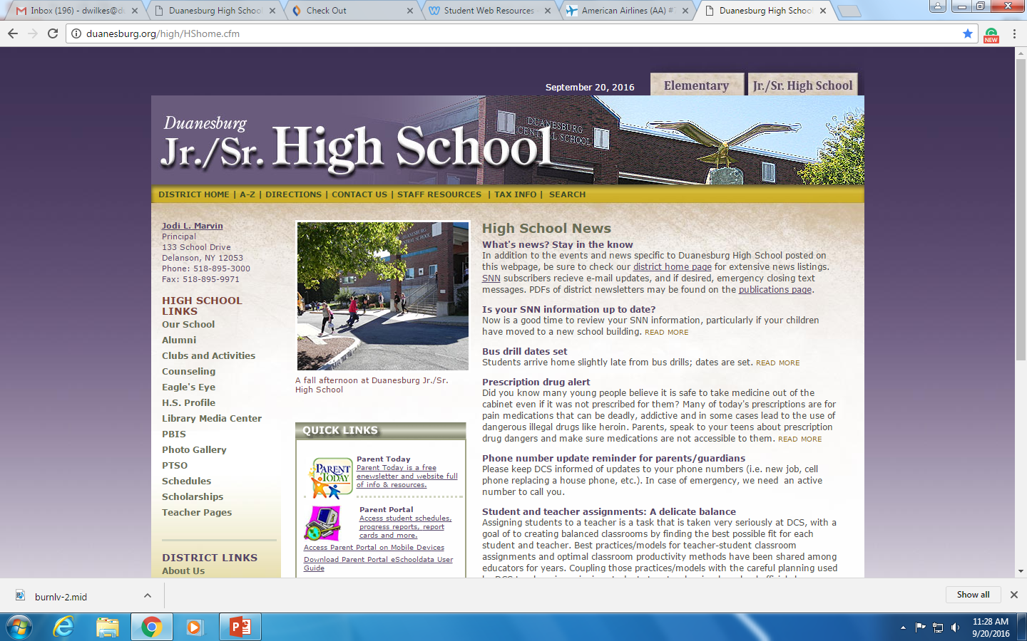
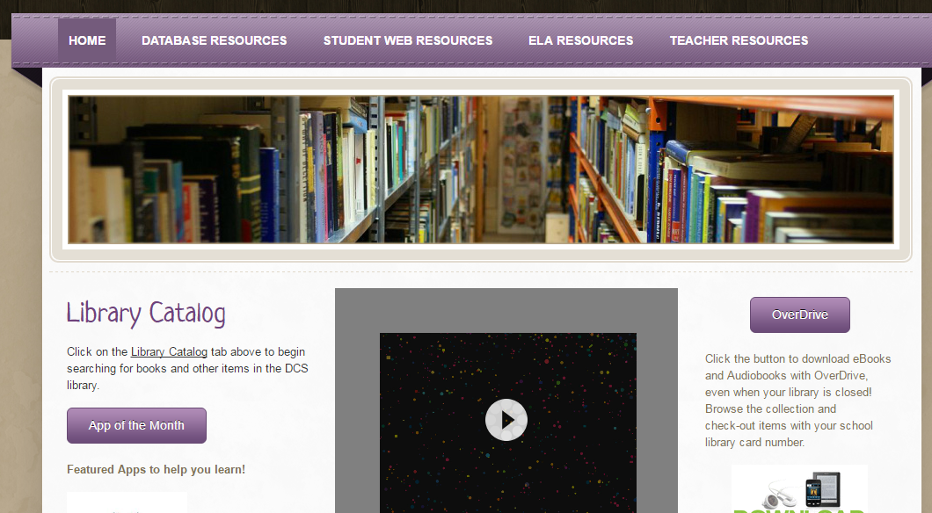
1. Go to the HS Webpage and click on Library link
2. Choose the Student Web Resources Page
3. Scroll to the bottom of the pace and find the link to 6th grade diglit Blog Site, then evaluate 3 of the links using the “Evaluating a Web Site for Research Rubric”

